Slide 1
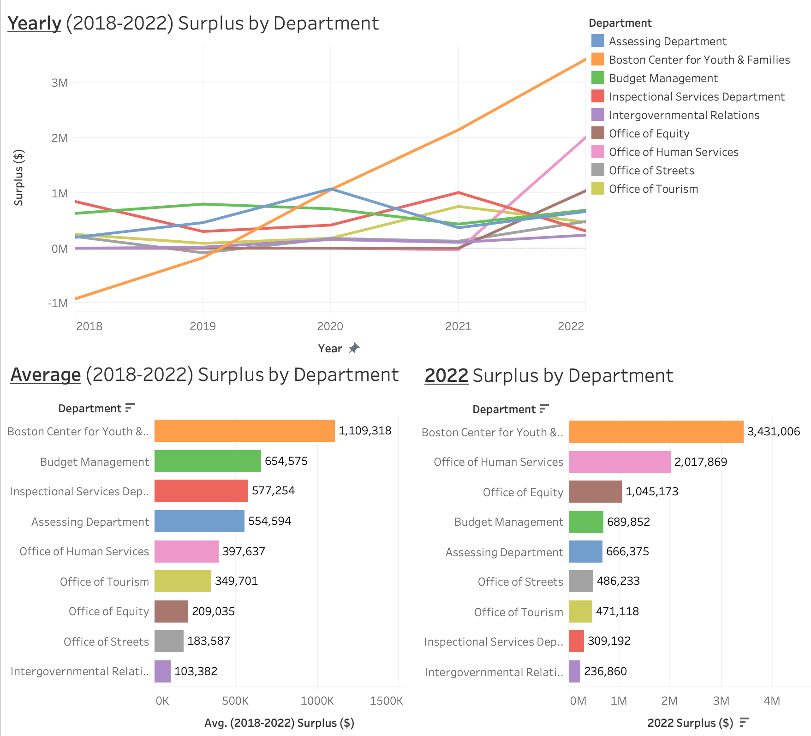

CENTER FOR ECONOMIC DEMOCRACY (CED) BUDGET ANALYSIS
Bella Davies (DS ‘24), Xiao Guo (COM ‘24), Sahir Doshi (DS ’24), Phillip Kim (DS ‘24)
PROJECT SUMMARY
The goal of this project is to show that more of the City of Boston’s operating budget money could be shifted towards participatory budgeting, from which members of the public are allowed to decide how to allocate resources. Though $40 million was requested, only $4 million has been allocated towards participatory budgeting.
Using data from the past five years, we want to identify where there is an underutilization, or underspending, of past budgets in order to advocate for this shift. In addition, we want to explore how the budget may be freed from other areas where it is being utilized, such as in the police budget.
PROJECT RESULTS
Key Questions:
Is there any underutilization of operational budget from the last several years from which we can advocate for a transfer of the variance to participatory budgeting?
How much money would be saved from overtime hours worked by police officers if civilian flaggers were used instead?
Goal:
Use the City of Boston’s Operating Budget data to identify the top departments of interest which have high budget transfer feasibility and high surplus, then break these down by Personnel costs and Non Personnel costs, and investigate how much is being spent on overtime.
We created dashboards to show the difference between spending and budget, the ratio of personnel spending, and programs with the highest surplus for each department. We also made a dashboard highlighting overtime hours and pay. View our full presentation and all dashboards at:
https://tinyurl.com/ced-budget
DATA VISUALIZATION
In 2022, the total feasible transferable surplus from departments of interest was $9.4M. The departments of interest are composed of departments with the most surplus in 2022 and highest feasibility rankings for transfer of funds.
CLIENTS AND MENTORS
Clients: Center for Economic Democracy
PM: Lavya Midha
TPM: Handi Xie
Partners: BU SPARK!
REFLECTIONS
Although departmental budgets fluctuate each year, the chart of average surplus indicates that on average there is a sufficient amount of surplus from these departments in the last 5 years. Personnel spending is the highest expense category in most departments.
TECH STACK / PROCESSES
Data Visualization Software: Tableau
Data Analysis Language: SQL

Slide 2
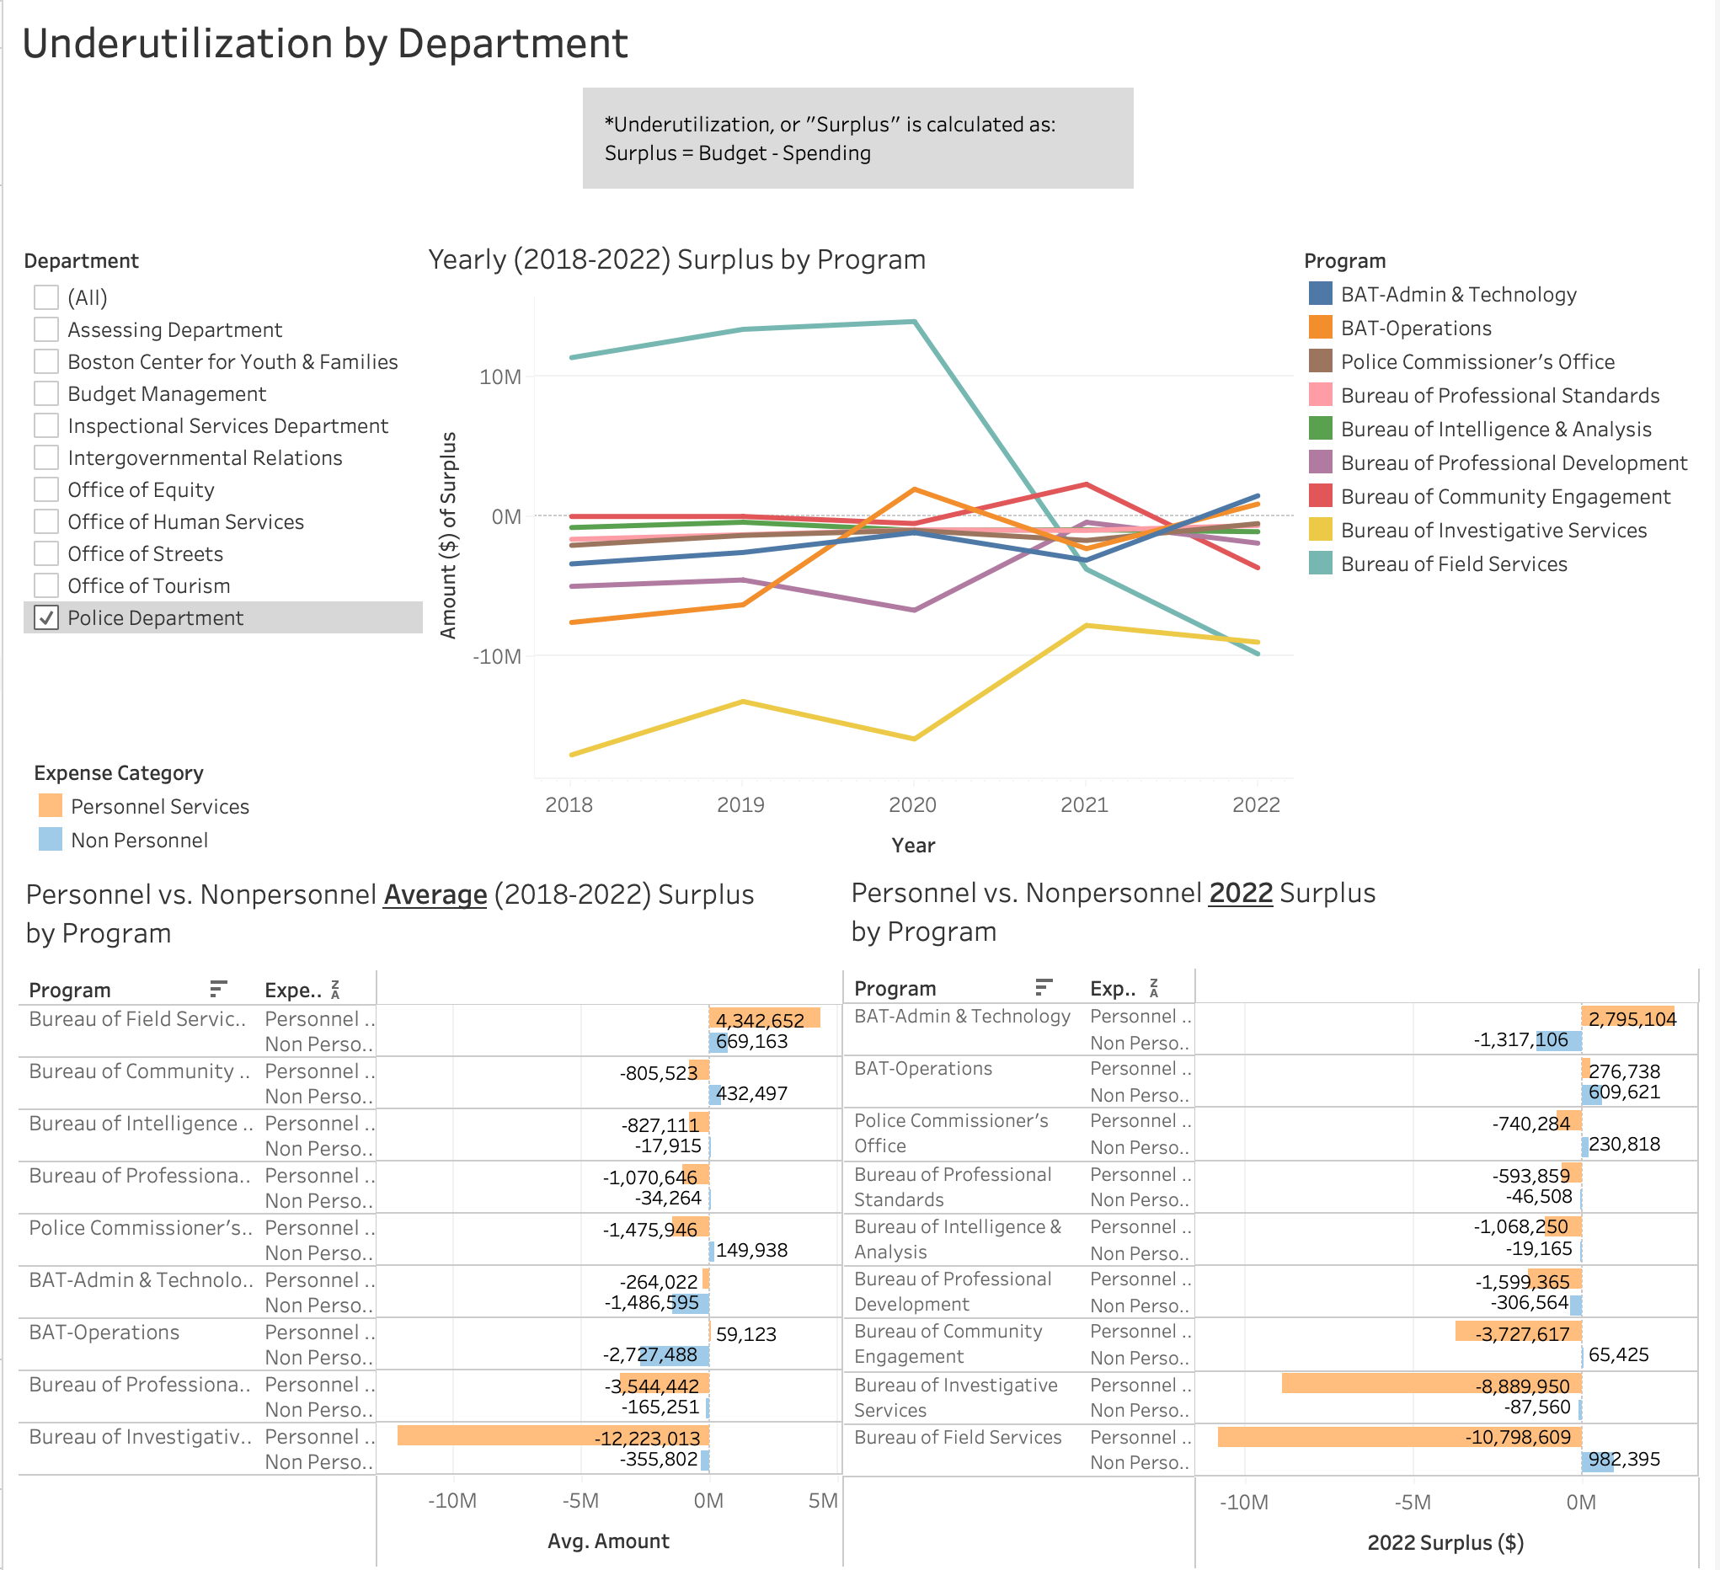
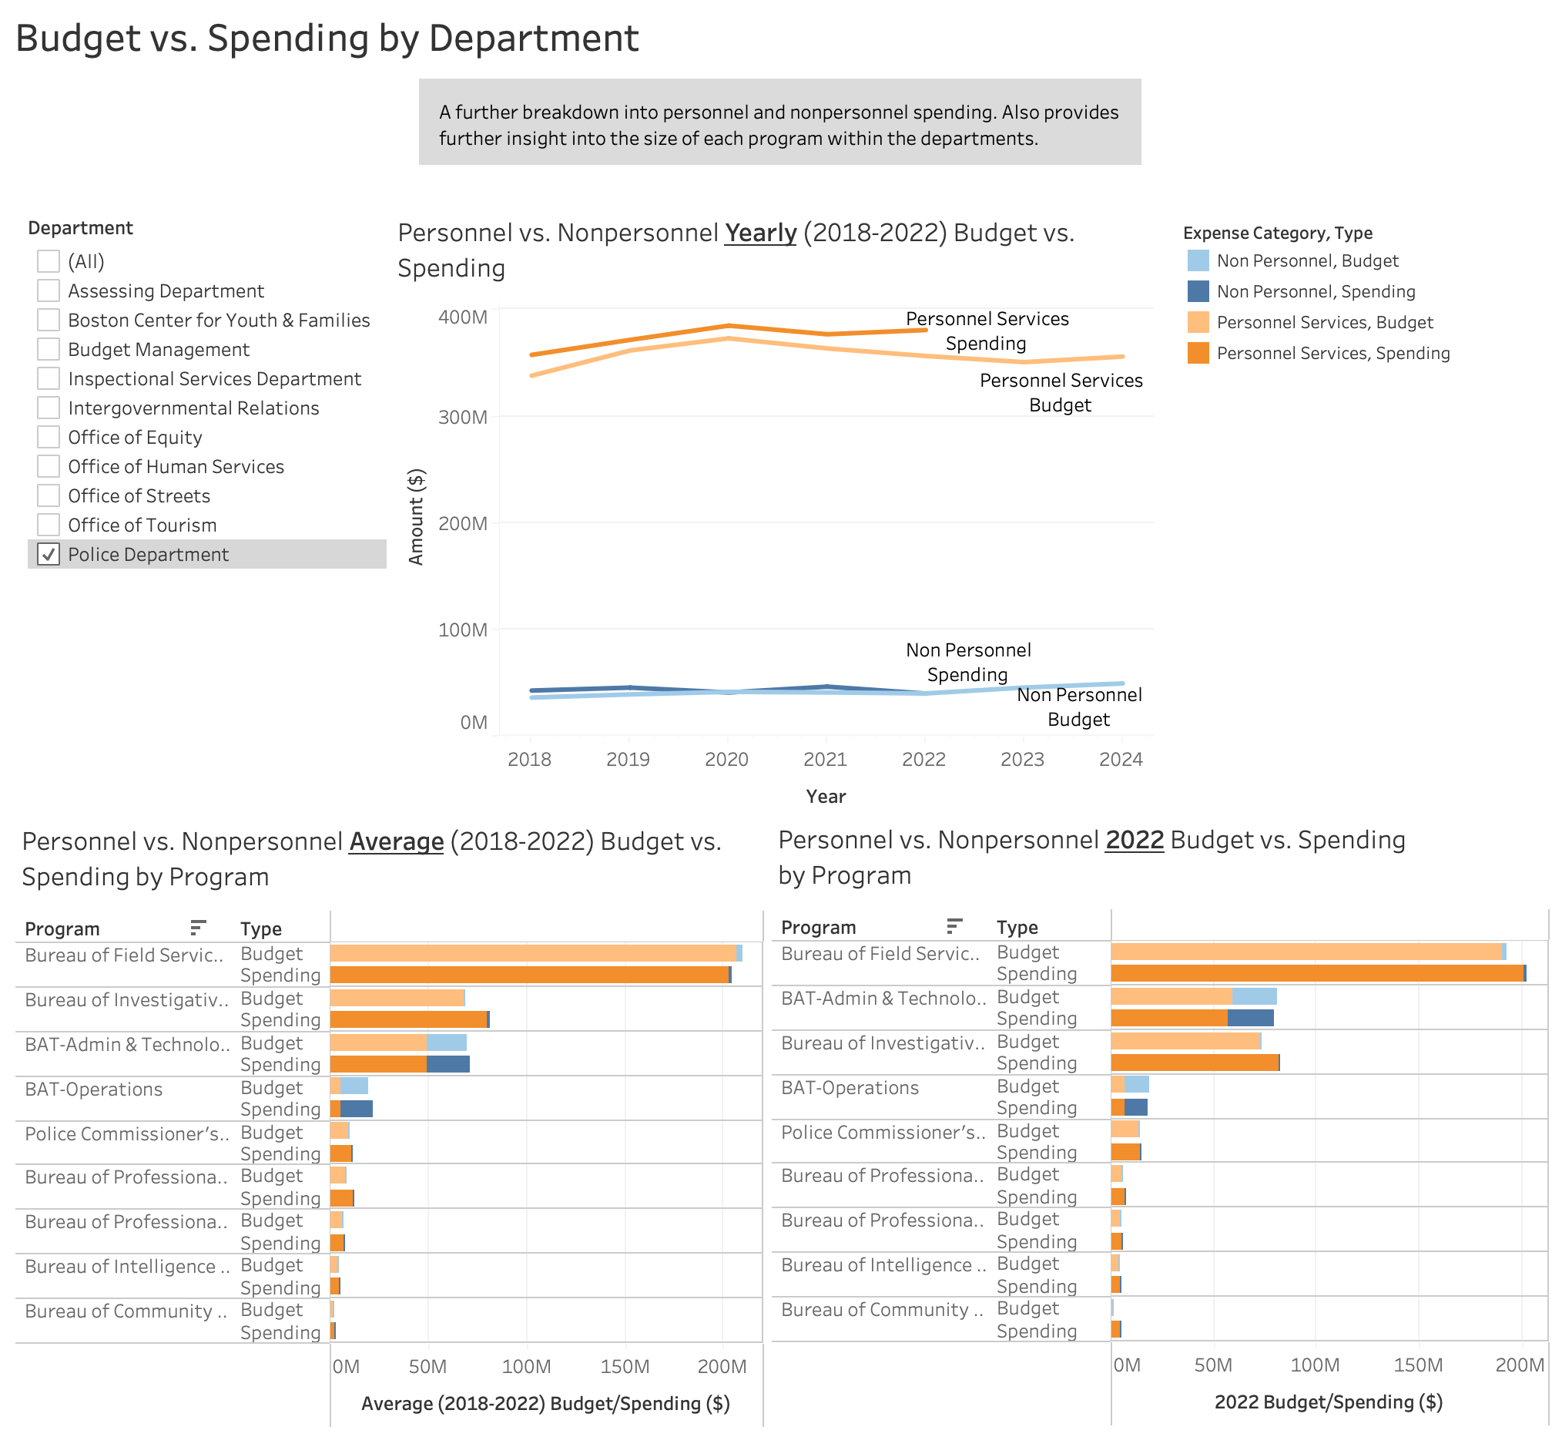
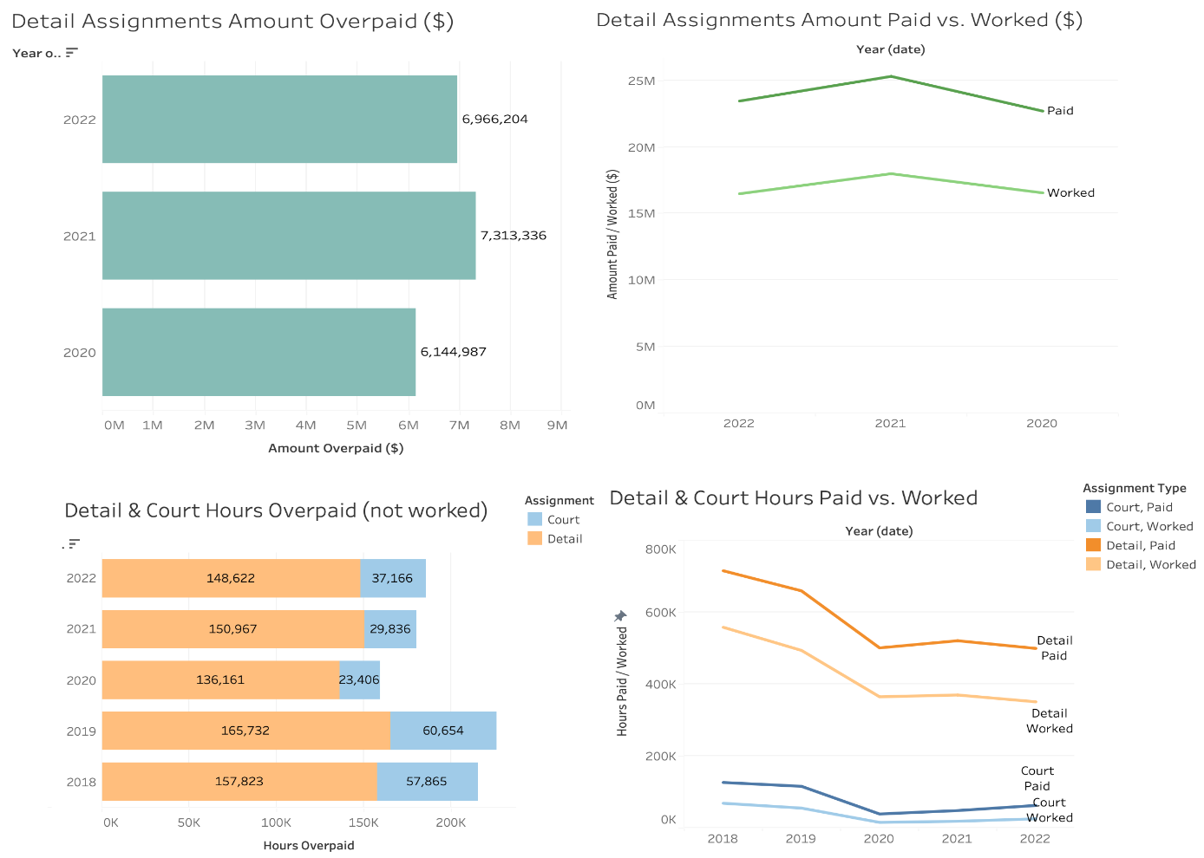
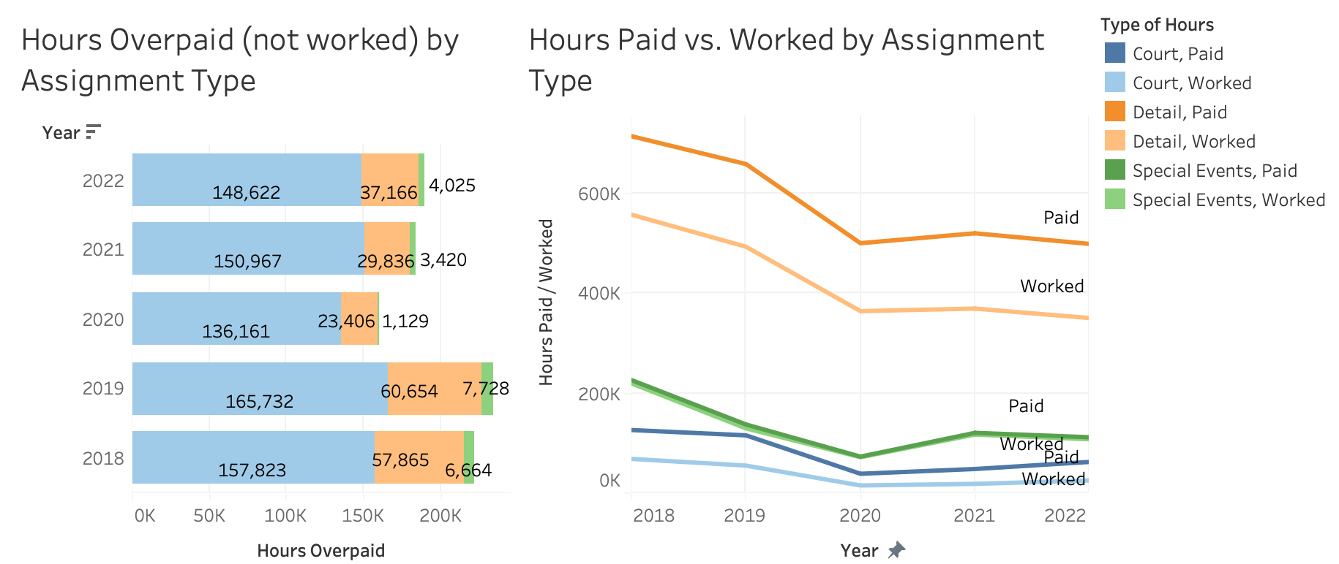
1. UNDERUTILIZATION
1. BUDGET / SPENDING
In 2022, the Boston Police Department showed overspending of their budget by $24M. Most of the negative surplus is for the expense category of Personnel Services, shown in orange. BAT Admin & Technology had around $1.5M in surplus and BAT Operations had around $886K.
In recent years, personnel spending has been significantly higher in the Boston Police Department than all other expense categories. The Bureau of Field Services program spends the most. BAT Admin & Technology and BAT Operations spend a higher percentage on non personnel expenses.
2. OVERTIME PAY
2. OVERTIME HOURS
In 2022, there was around $7M overpaid (for hours not worked) to police officers in the Boston Police Department for just detail assignments. This is around 27% of total payment for detail assignments. There is likely more money overpaid for other assignments.
There is additional payment for overtime hours not worked for all assignment types, including detail, court, and special events.
In 2022, there were around 189.8K hours overpaid. Around 148.6K were for detail assignments, 37.2K were for court assignments, and 4K were for special events assignments.

